Slide 1
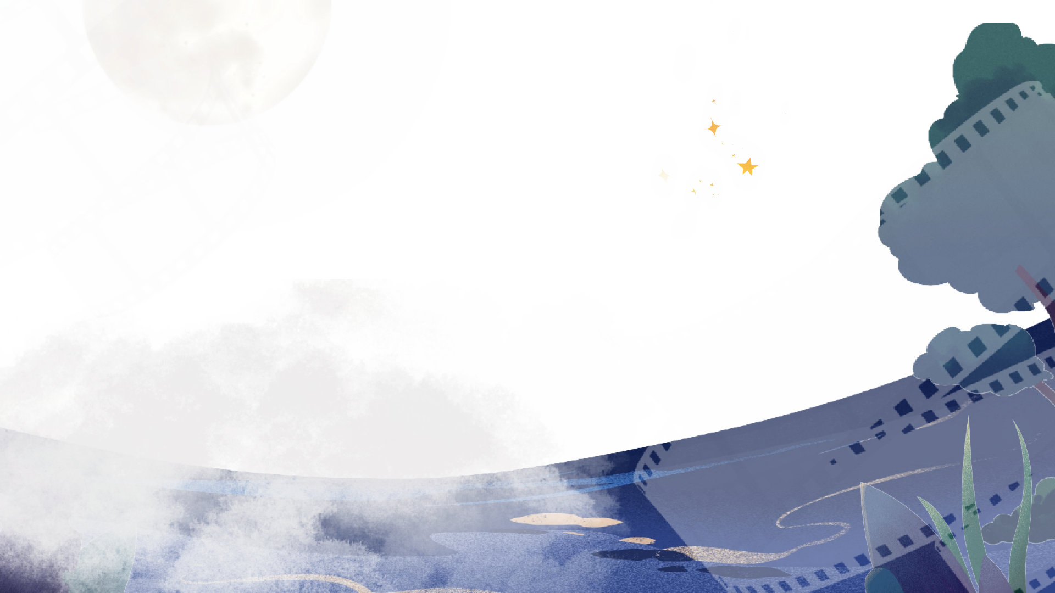



ChronoLens
Transforming Videos into Searchable Knowledge.
TEAM MEMBERS
Srivarsha Suresh (23619235)
Visruthaa kk (23619215)
Sounthar R (23619233)
GUIDE
Mrs.P.MohanaPriya

Slide 2

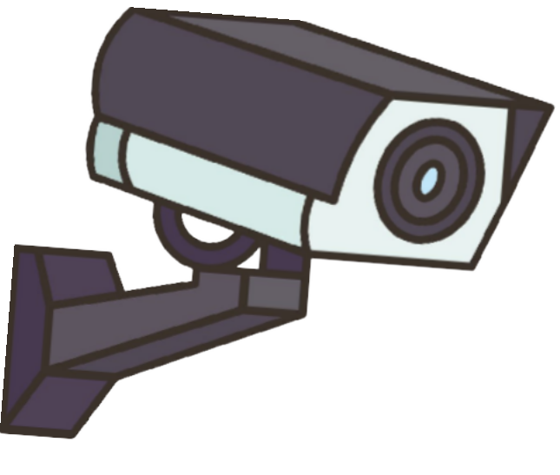
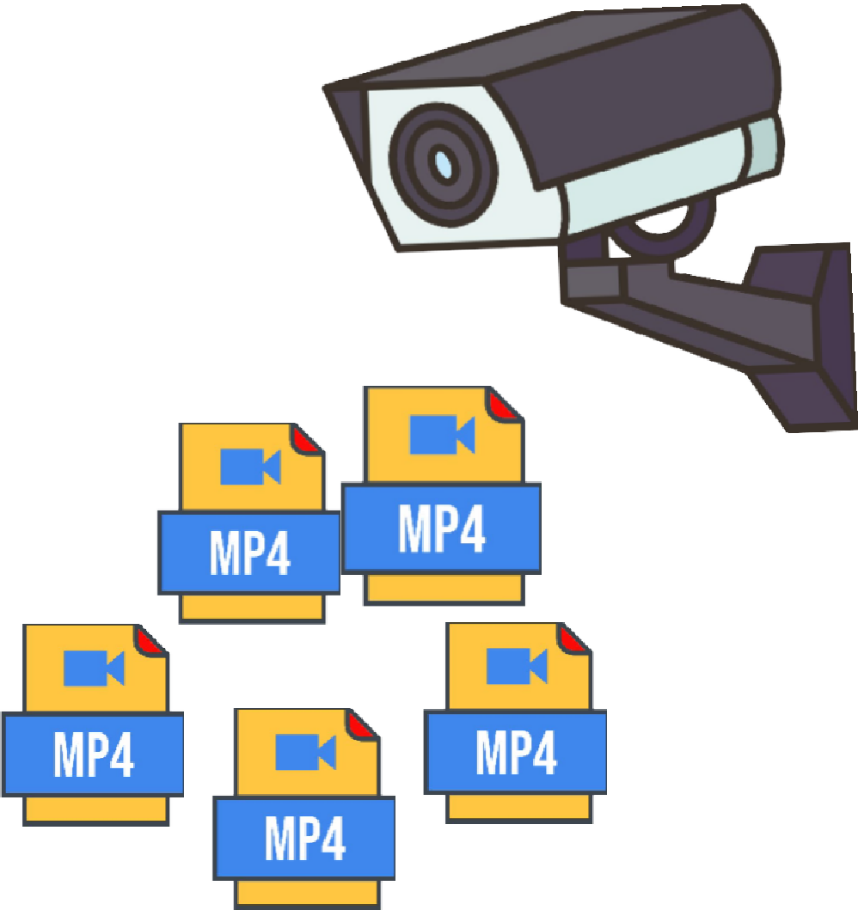
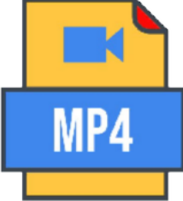





PROBLEM
There are huge amounts of videos today, and finding a specific moment by watching everything is slow and painful. This project builds a system where you can just ask a question in plain English and get the right answer from the video — with proof, not guesses.
Most current systems have 3 problems:
Manual Video Search
  Long videos require time-consuming inspection.
Limited Retrieval
⚬ Traditional methods struggle with visual and contextual queries.
Lack of Evidence
  Finding a result is not enough; users need the exact moment and visual proof.

Slide 3

OBJECTIVE
Intelligent Video Indexing
Develop an AI-powered pipeline to detect, track, and index objects, attributes, scenes, and speech from video content.
Natural-Language Video Retrieval
Enable users to search videos using natural-language queries and retrieve relevant objects, people, events, and spoken content.
Precise Evidence & Verification
Provide relevant video clips, timestamps, track-level evidence, and visual/audio proof to make retrieved results easily verifiable.

Slide 4
LITERATURE REVIEW
Paper (Source, Year) | Limitations / Gaps | How We Fix It
Towards RAG over Large Video Libraries — Tevissen et al., IEEE HSI, 2024 | Fixed 3-frame sampling; no counting/duration; no event reasoning; hallucination risk; no reranker | ASFS (smart sampling) + TERE (event reasoning, acts as reranker) + Grounded Narrative Generation (reduces hallucination)
VideoRAG (graph-based) — Ren et al., ACM SIGKDD, 2026 | Graph is built to improve answer generation quality, not to answer time-based questions | TERE's graph is purpose-built to answer "what happened before/after" style queries
Adaptive Keyframe Sampling (AKS) — Tang et al., IEEE/CVF CVPR, 2025 | Picks frames per single question at inference time; not built for a persistent, reusable index | ASFS builds a query-independent index once, reusable for any future question
Video-Enriched RAG — Dela Rosa, SIGIR MRR Workshop, 2024 | Shows transcript-based retrieval beats visual-only retrieval, but doesn't fuse object detection, OCR, or event order | System fuses YOLO + CLIP + OCR + Whisper, plus TERE for event order
CLIP4Clip — Luo et al., Neurocomputing, 2023 | Models frame sequence via attention, but no real event relationships (before/after/during) | TERE builds a proper event graph with explicit temporal relations

Slide 5

PROPOSED SYSTEM
An AI-powered video intelligence and retrieval system for searching large video collections using natural-language queries
Multimodal Video Indexing
Extracts and indexes objects, people, visual attributes, scenes, and speech from videos.
Intelligent Search & Retrieval
Understands the query and selects the appropriate retrieval method using FAISS, object search, attribute analysis, and transcript search.
Evidence-Based Results
Returns relevant video clips, timestamps, representative track crops, and speech evidence for direct verification.

Slide 6
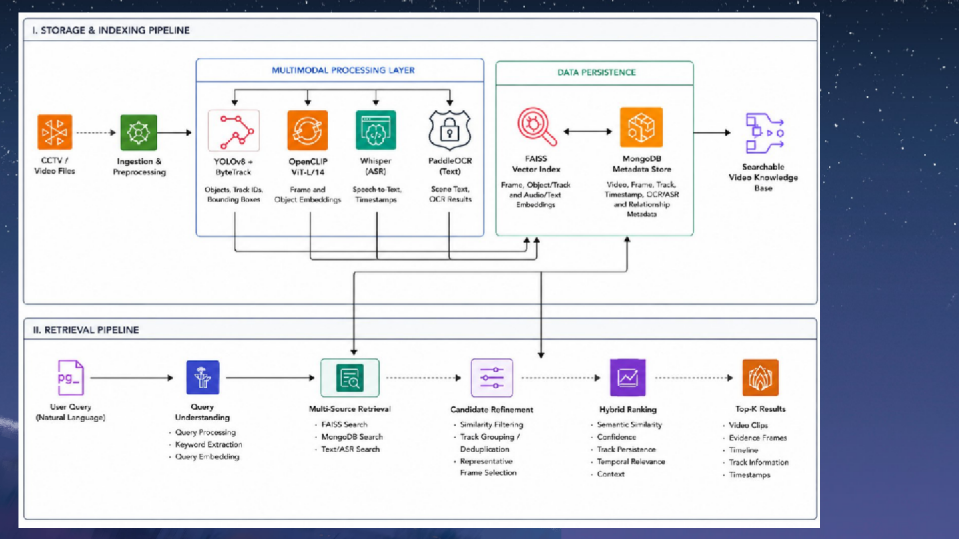
Architecture
A R C H I T E C T U R E

Slide 7
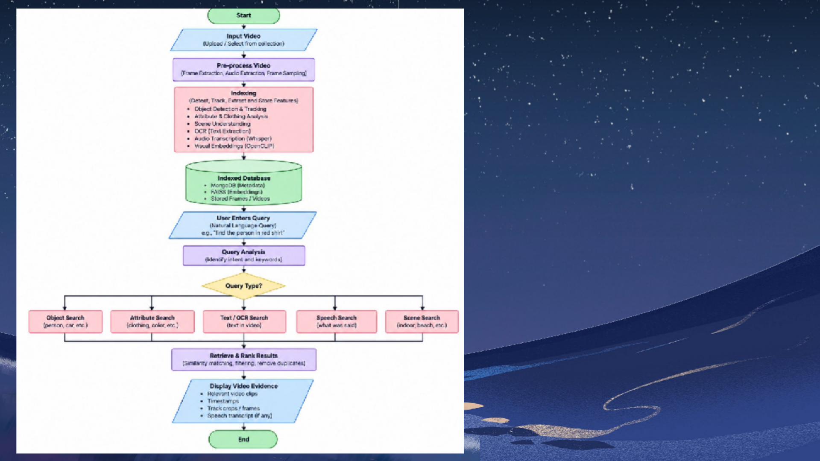
Architecture
FLOW
DIAGRAM

Slide 8
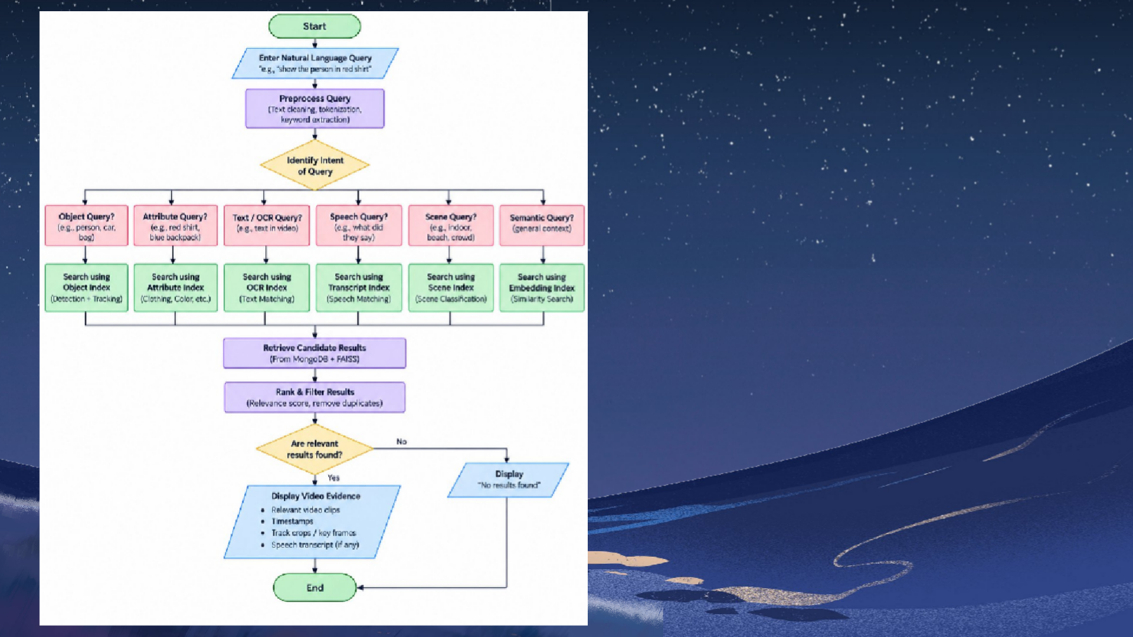
Architecture
FLOW CHART

Slide 9
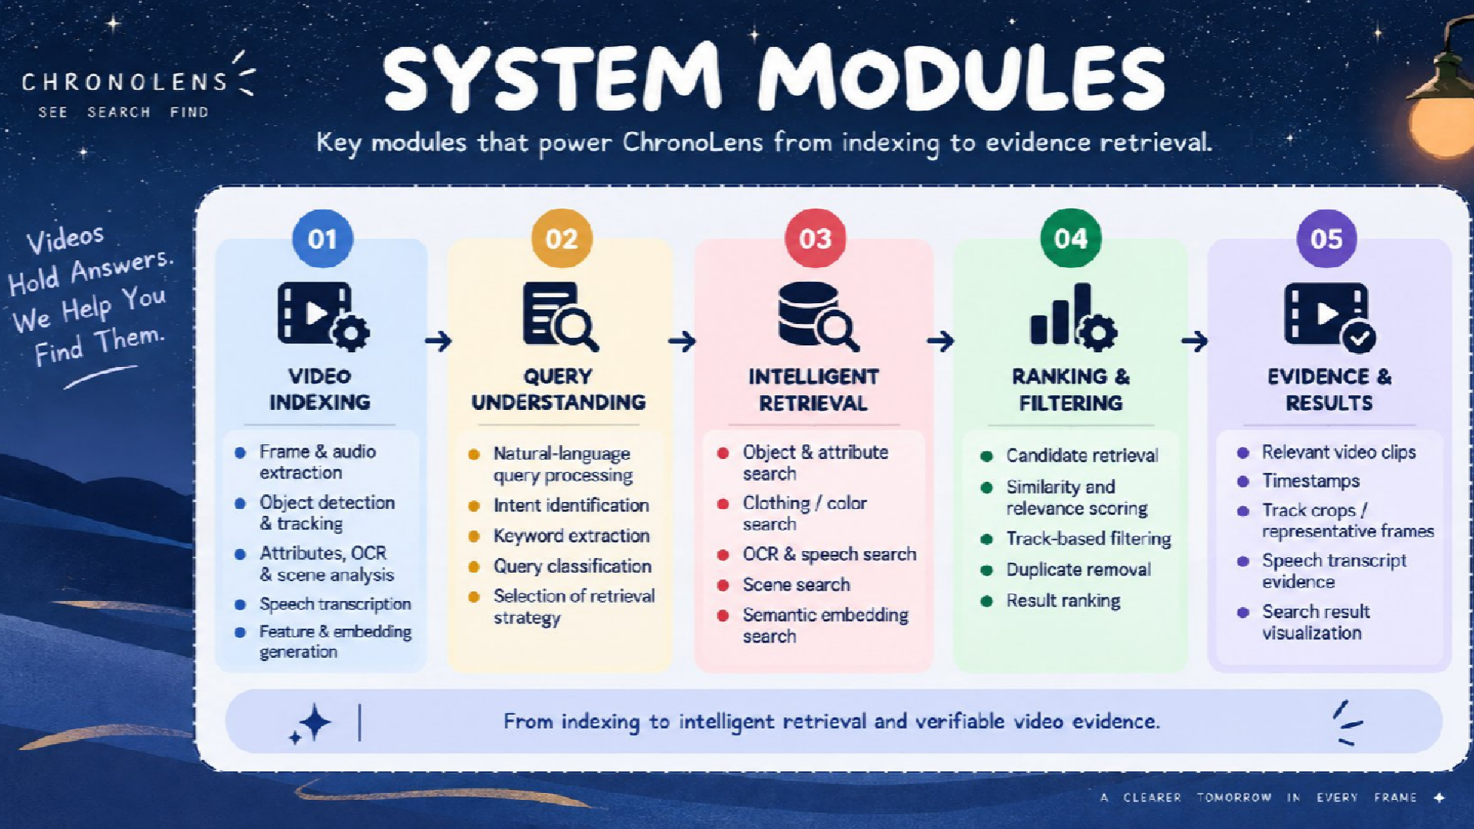

Slide 10
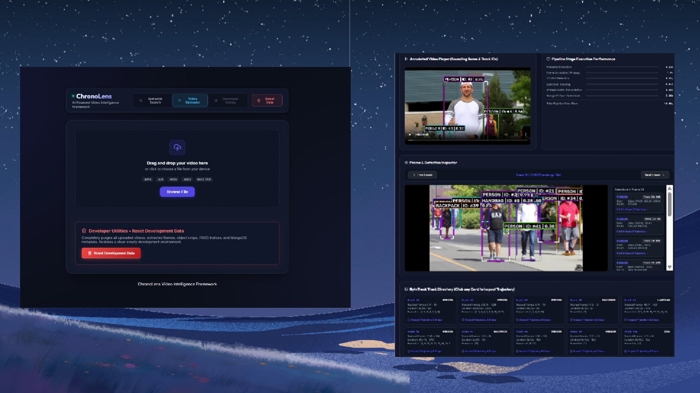
AIMrPcLEhMitEeNTcAtTuIOreN
VIDEO UPLOAD & PRE-PROCESSING
VIDEO INDEXING

Slide 11
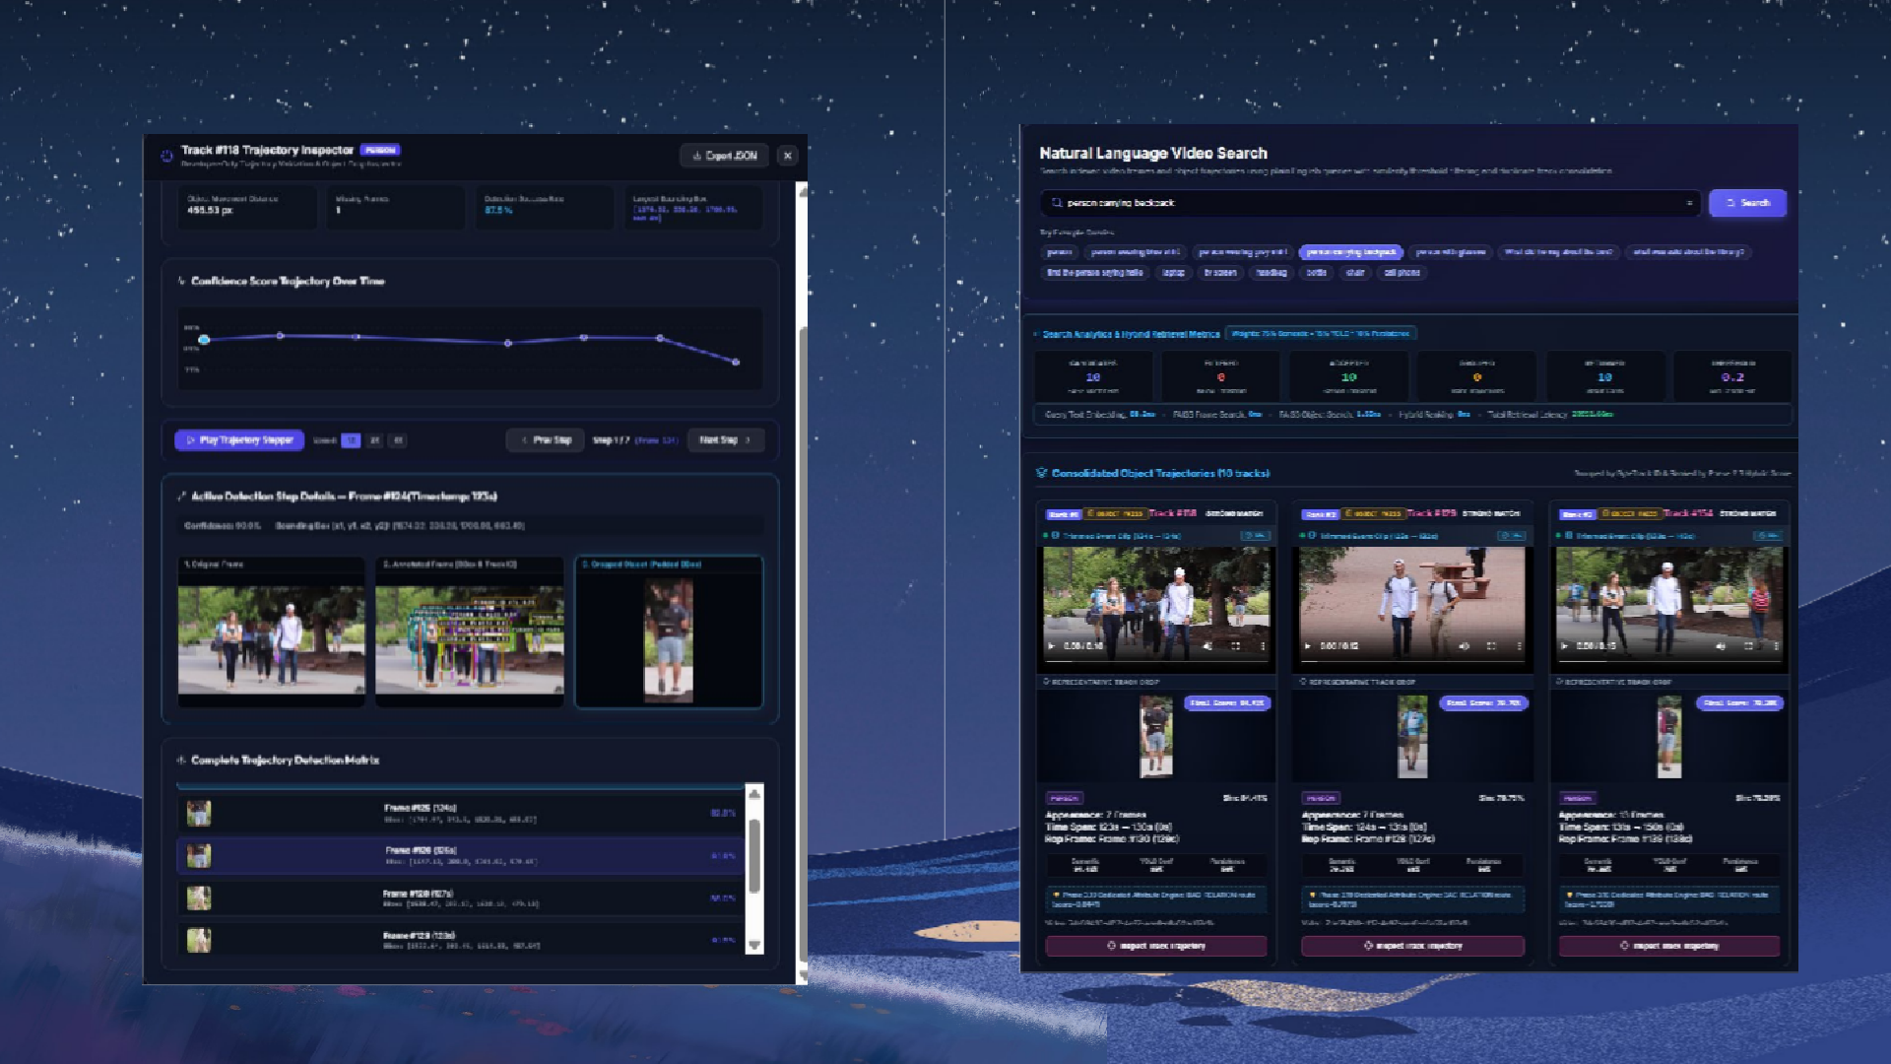
AIMrPcLEhMitEeNTcAtTuIOreN
EVIDENCE & VERIFICATION
RETRIEVAL WITH PROOF

Slide 12
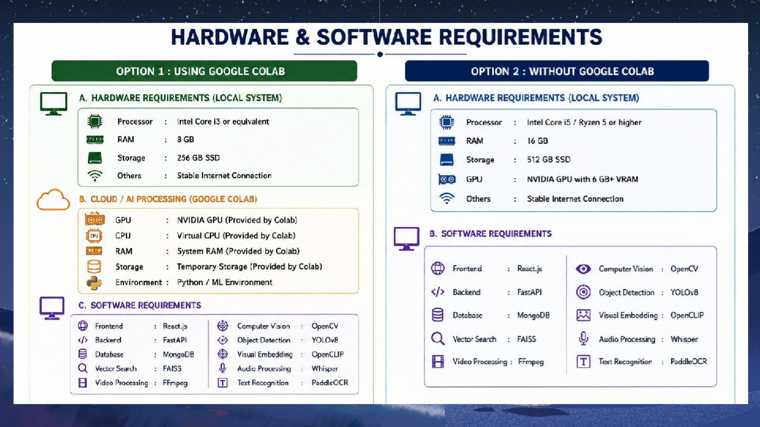
Architecture

Slide 13
RESULT
The 68.2% R@1, 84.1% R@5, 91.6% R@10, and 73.8% mAP@10 were obtained on the evaluated 107-query benchmark using the tested video and evaluation setup. Performance can change when ChronoLens is evaluated on different videos because scene conditions, object distribution, camera viewpoints, lighting, and video complexity may vary.
R@1 = 68.2% → The correct/relevant result appeared in the top-ranked result for 68.2% of the evaluated queries.
R@5 = 84.1% → The top 5 retrieved results contained a relevant result for 84.1% of the evaluated queries.
R@10 = 91.6% → The top 10 retrieved results contained a relevant result for 91.6% of the evaluated queries.
mAP@10 = 73.8% → The system achieved 73.8% mean average precision across the top 10 retrieved results, indicating improved ranking quality.
MRR = 0.75 → The average reciprocal rank of the first relevant result was 0.75, indicating that relevant results generally appeared near the top of the ranking.
False-Positive Rate = 8.0% → Only 8.0% of the negative-control queries were incorrectly accepted as positive matches.
Mean Query Latency = 2.81 seconds → The complete ChronoLens pipeline returned the final Top-K results in an

Slide 14
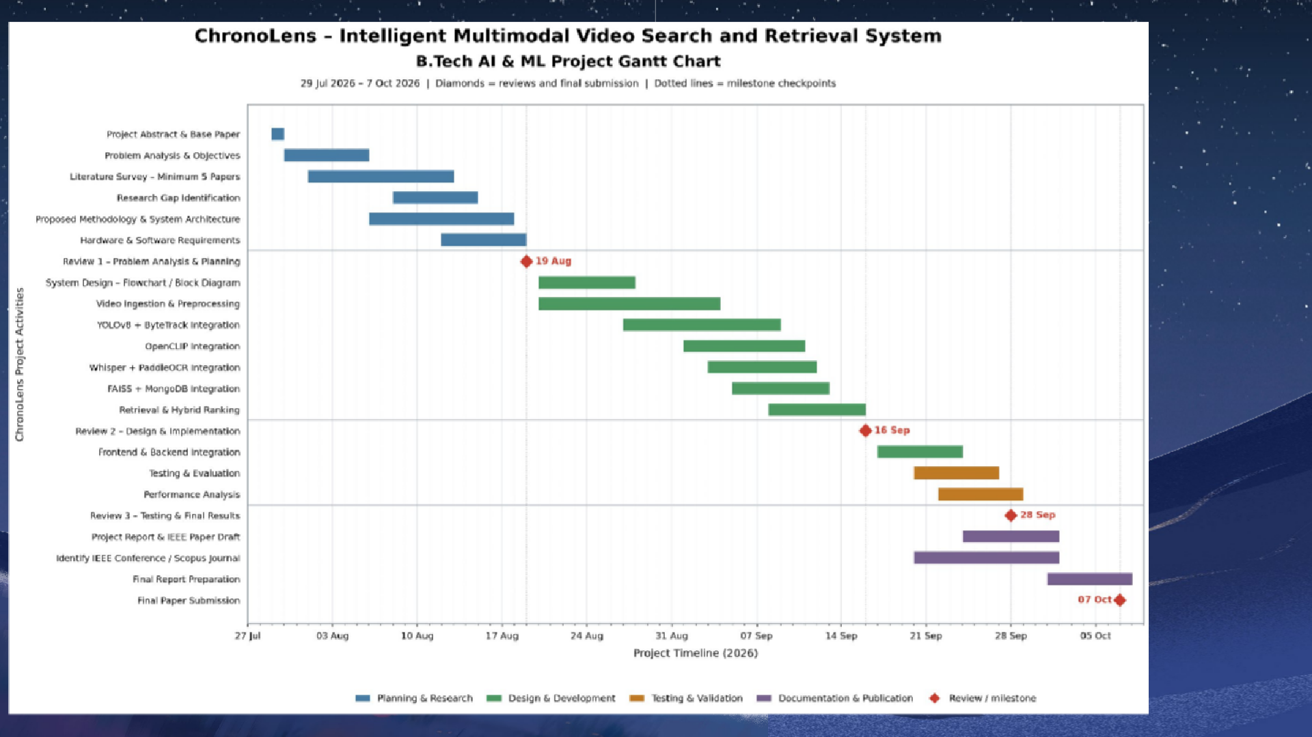
Architecture
G A N T T
C H A R T

Slide 15
CHALLENGES FACED
— ATTRIBUTE RECOGNITION
Attributes such as glasses, hats and bags were difficult to identify consistently across different viewpoints.
Solution:
Integrated PAR selectively with visual/crop-based evidence.
— CLOTHING COLOR VARIATION
Lighting, shadows and low-saturation colors caused confusion between similar clothing colors.
Solution:
HSV/LAB color analysis combined with OpenCLIP visual evidence.
— SPEECH TRANSCRIPTION
Whisper transcription accuracy depended on audio quality and the clarity of spoken phrases.
Solution:
Whisper large-v3-turbo + improved audio preprocessing.
— TRACK & EVIDENCE ALIGNMENT
Incorrect frame/crop associations could lead to misleading visual evidence.
Solution:
Exact TrackID + FrameNumber + Bounding Box alignment.

Slide 16



FUTURE WORK
Future
Action & Event Understanding
“Find the person who falls near the entrance.”
Advanced Temporal Search
“Find the person who enters the room and leaves after 2 minutes.”
Multi-Modal Querying
“Find the person in a red shirt who said ‘stop’.”
Improved Person & Attribute Analysis
“Find the person wearing a black shirt and carrying a backpack.”
Intelligent Video Summarization
“Summarize all important events between 2 PM and 4 PM.”

Slide 17
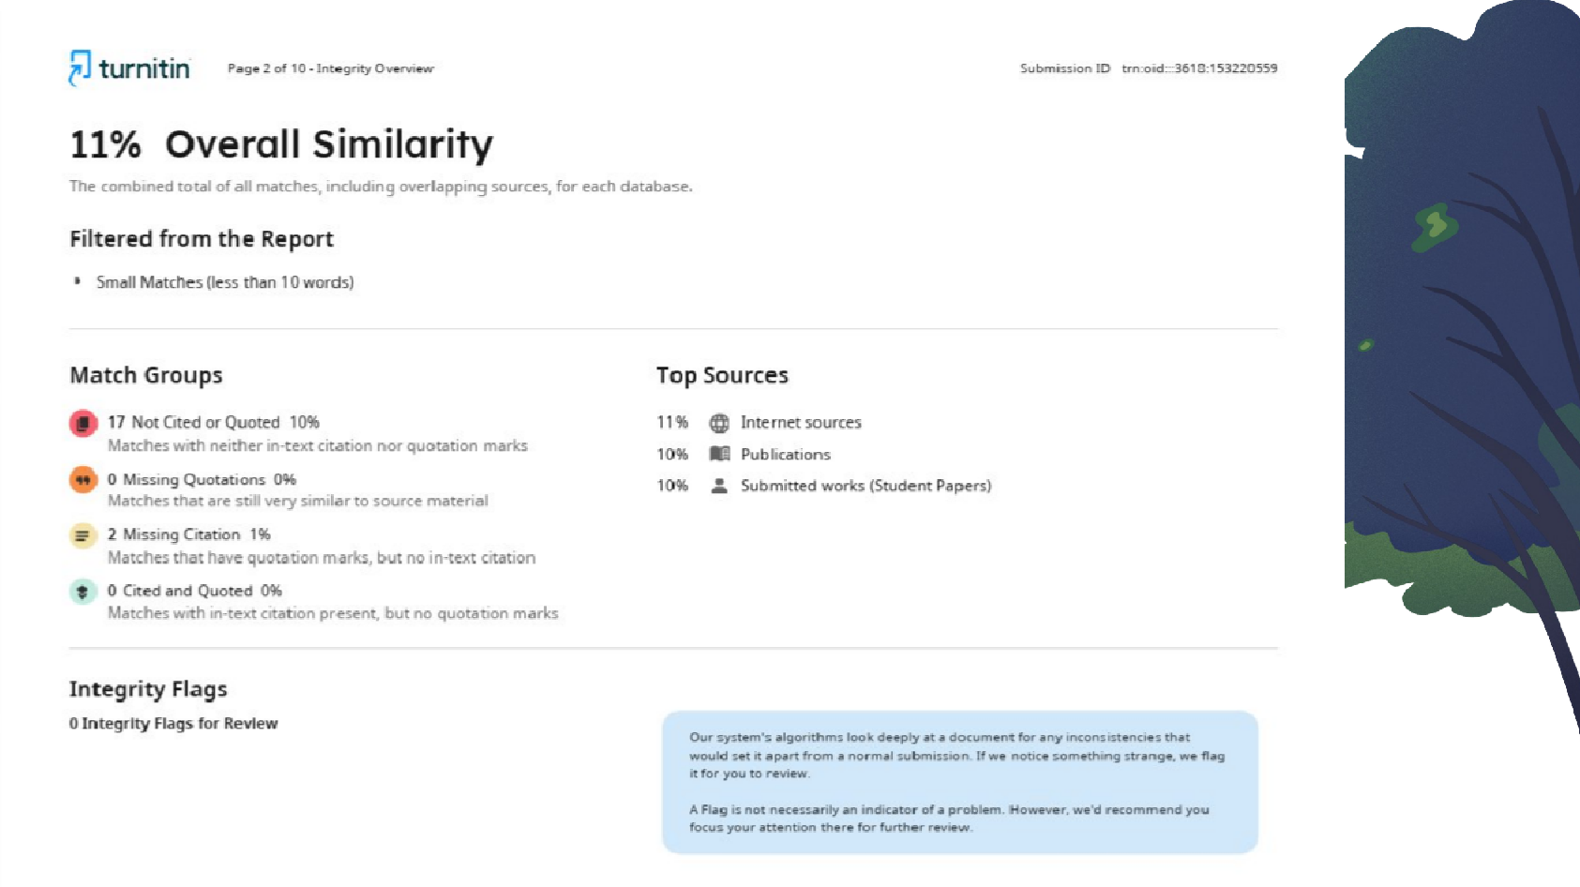


Slide 18
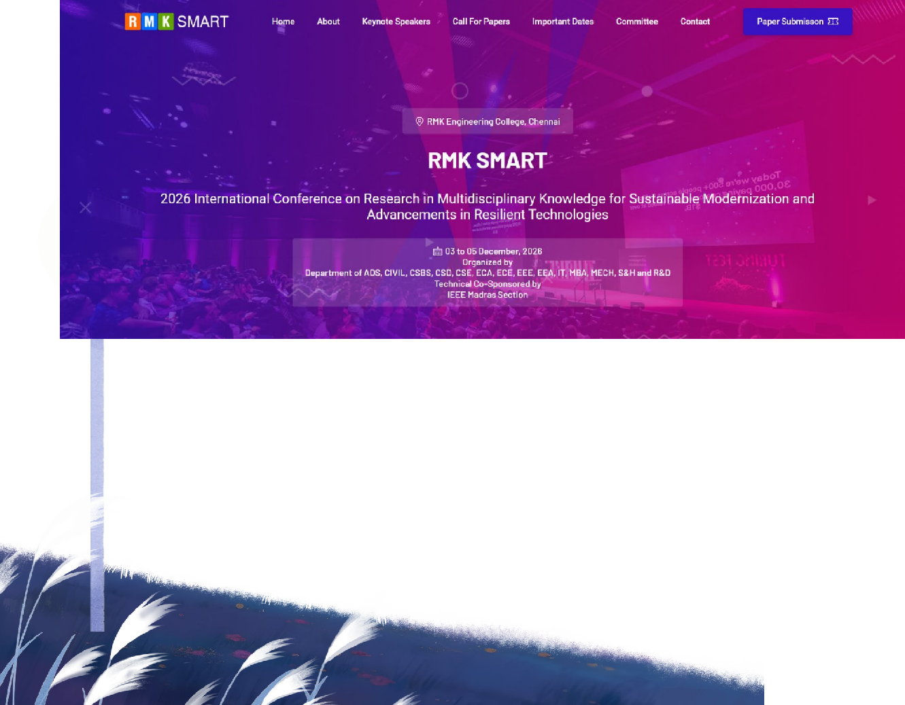
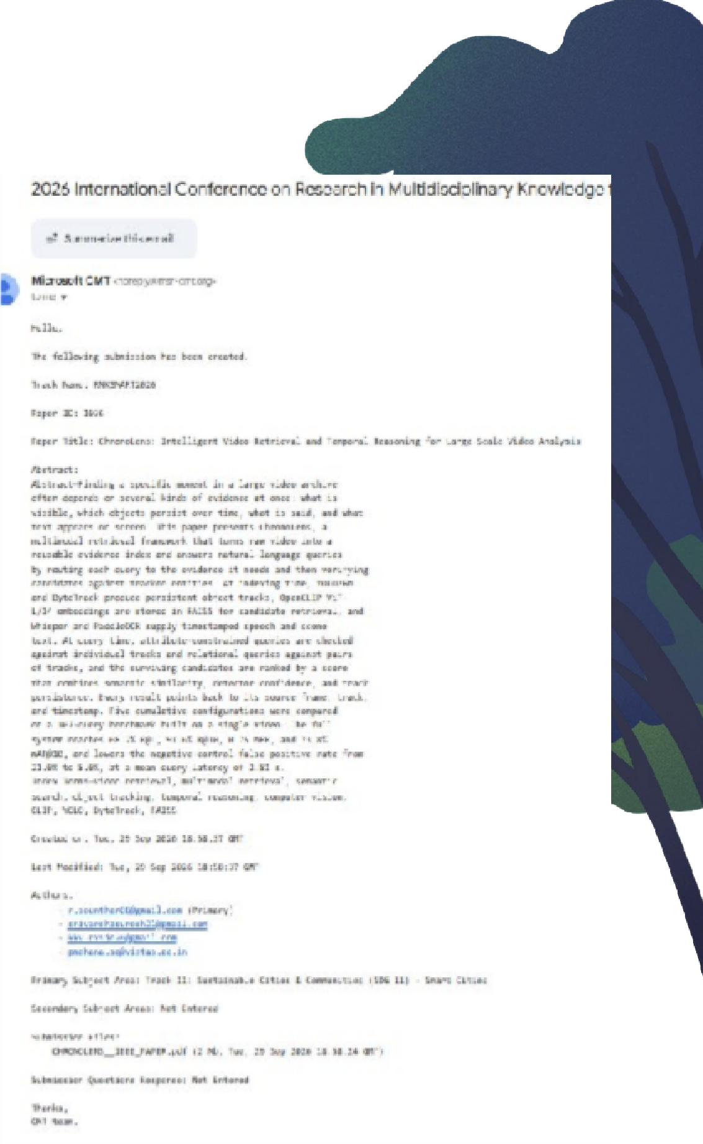

Slide 19



Thank You

